Slide 1


Welcome
Abroad
02 MAY, 2024

Slide 2





Hello!
Welcome to Property Master. We're stoked to have you with us. Your energy and skills are exactly what we need, and we can't wait to see the awesome things we'll achieve together. Feel at home, ask anything, and let's make work a blast.

Slide 3








Agenda Overview
About Our Company
Our Vision and Mission
Benefits and Perks
Employee Wellness Snapshot

Slide 4





About Our Company
Welcome to our company. We're not just a workplace, we're a close community driven by innovation and diversity. Our mission guides us, and your energy and skills are exactly what we need. Join us in pushing boundaries and making a positive impact. Welcome to a place where your ideas count, your growth matters, and together, we're building something
extraordinary.

Slide 5




Our Vision and Mission
OUR MISSION
OUR VISION
Our mission is to innovate relentlessly, inspire
positive transformation, and make a lasting impact. We are dedicated to delivering products of the highest quality, driven by a commitment to
excellence, integrity, and social responsibility.
Our vision is to be a catalyst for positive change, empowering individuals and communities to thrive.

Slide 6

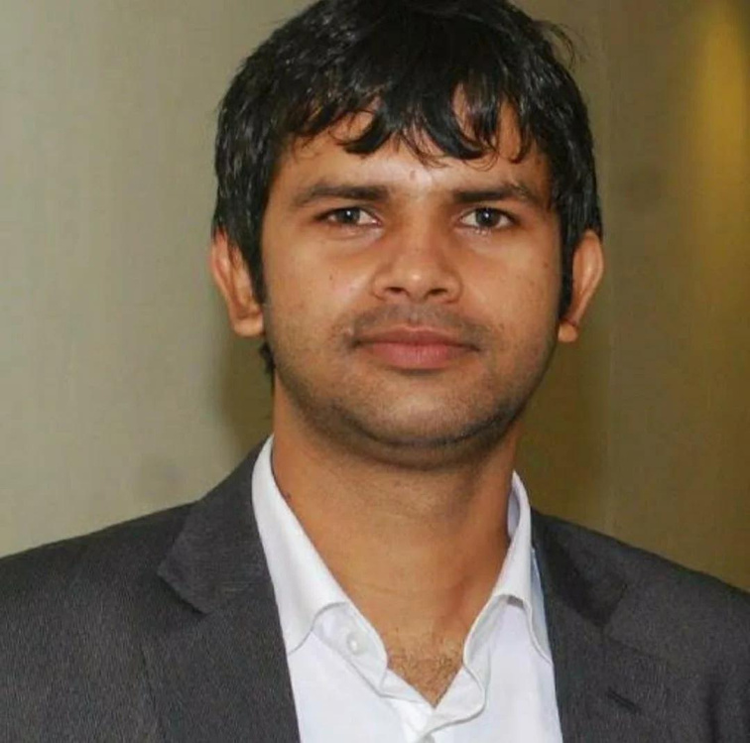
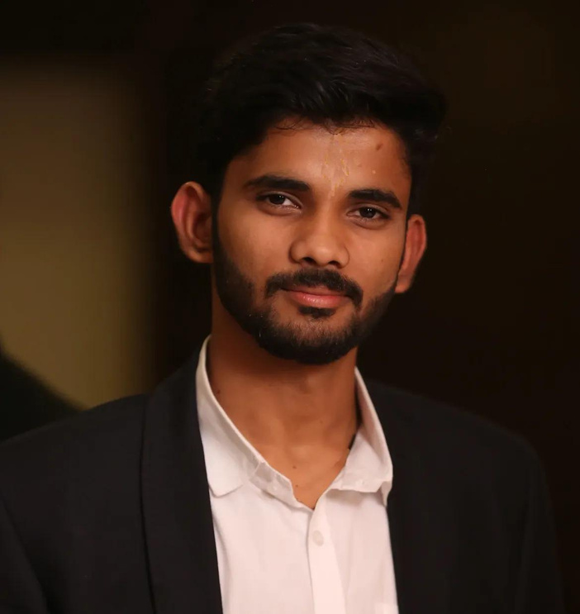
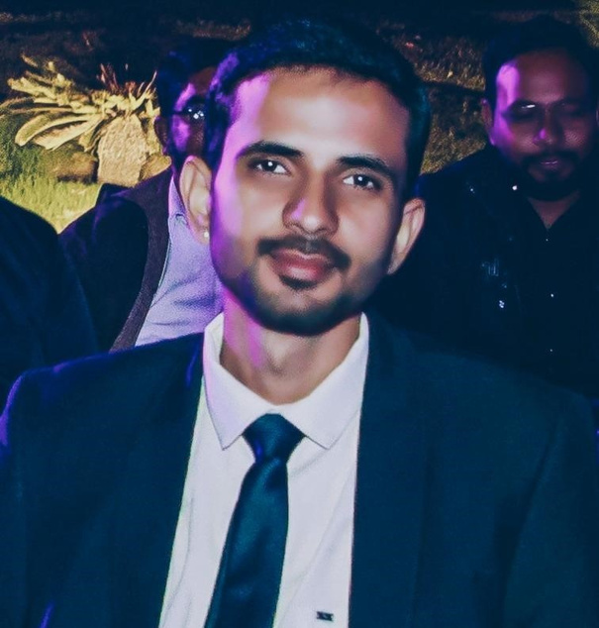

Our Team
Jitendra Singh
Abhimanyu Singh
Aditya Singh
Managing Director
Director
IT & Social Media Head

Slide 7

Your Role and Responsibilities
Welcome aboard as our new Digital Marketing Specialist. In this dynamic role, you'll be at the forefront of our online presence and brand strategy.
KEY RESPONSIBILITIES:
Lead and execute digital marketing campaigns.
Manage our social media presence with strategic content. Optimize online visibility through SEO and compelling content.
Drive engagement and analyze performance metrics. Collaborate across teams for a cohesive brand strategy.

Slide 8

COLLABORATION AND INCLUSIVITY
We believe that diverse perspectives foster innovation, and every voice is valued. Expect a workplace where your ideas are not only heard but actively encouraged.
Company Culture
CONTINUOUS LEARNING AND GROWTH
OPEN COMMUNICATION AND TRANSPARENCY
We embrace a culture of continuous learning. Your professional growth is a priority, and we provide resources, mentorship, and opportunities for skill development.
Communication is at the heart of our culture. We believe in transparency and open dialogue at all levels.

Slide 9


Benefits and
Perks
Enjoy wellness programs, team-building activities, and social events. Your journey with us is not just about work, it's about thriving both personally and professionally. Welcome to a workplace that cares about you.

Slide 10



CODE OF CONDUCT
COMMUNICATION GUIDELINES
Upholding respect, integrity, and professionalism is at the core of our Code of Conduct, ensuring a safe and inclusive workplace.
Open and collaborative
communication is encouraged through regular team updates, meetings, and accessible management.
Policies and Procedures
WORK-LIFE BALANCE
PROFESSIONAL GROWTH
We prioritize a healthy work-life balance, offering flexible work hours to optimize productivity and personal well-being.
We invest in your professional development, providing opportunities for training, skill-building, and advancement within the company.

Slide 11




Training and Development
Our training program equips you with the skills and knowledge to thrive in your role and contribute meaningfully. From comprehensive onboarding to ongoing professional development opportunities, we provide the tools for success. Workshops, mentorship, and access to external resources ensure you stay ahead in your career. Welcome to a culture of continuous learning and innovation.

Slide 12



ERGONOMIC WORKSTATIONS
FLEXIBLE BREAK SPACES
Our workspaces are designed with your well-being in mind, featuring ergonomic furniture to support comfort and productivity.
Enjoy break areas designed for relaxation and socialization. Flexible spaces cater to various needs, whether you prefer a quiet corner or a collaborative setting.
Workspace and Facilities
HEALTHY SNACK OPTIONS
COLLABORATIVE MEETING SPACES
Our kitchen is stocked with a variety of healthy snacks to keep you fueled throughout the day. We believe in nourishing your body and mind.
Foster creativity and teamwork in our collaborative meeting spaces equipped
with modern technology, making communication and collaboration seamless.

Slide 13



Employee Wellness Snapshot
Our wellness program includes ergonomic workspaces, fitness facilities, and relaxation rooms. With healthy snacks and flexible break areas, we promote physical and mental
health. Beyond the workplace, we offer activities and workshops for a holistic
approach to well-being. Welcome to a workplace where your health is a priority.

Slide 14




Any Questions?
As we conclude your onboarding, we want to address any remaining questions you may have. This is your chance to seek clarification on any aspect of your role, company culture, or about our company. Your questions are valuable, and we're here to ensure you feel confident and well-informed. Let's make sure you're ready for the exciting journey ahead.

Slide 15




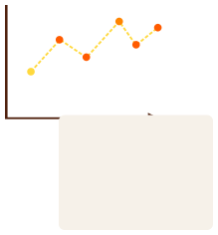









Thank you
02 MAY, 2024

